Slide 1
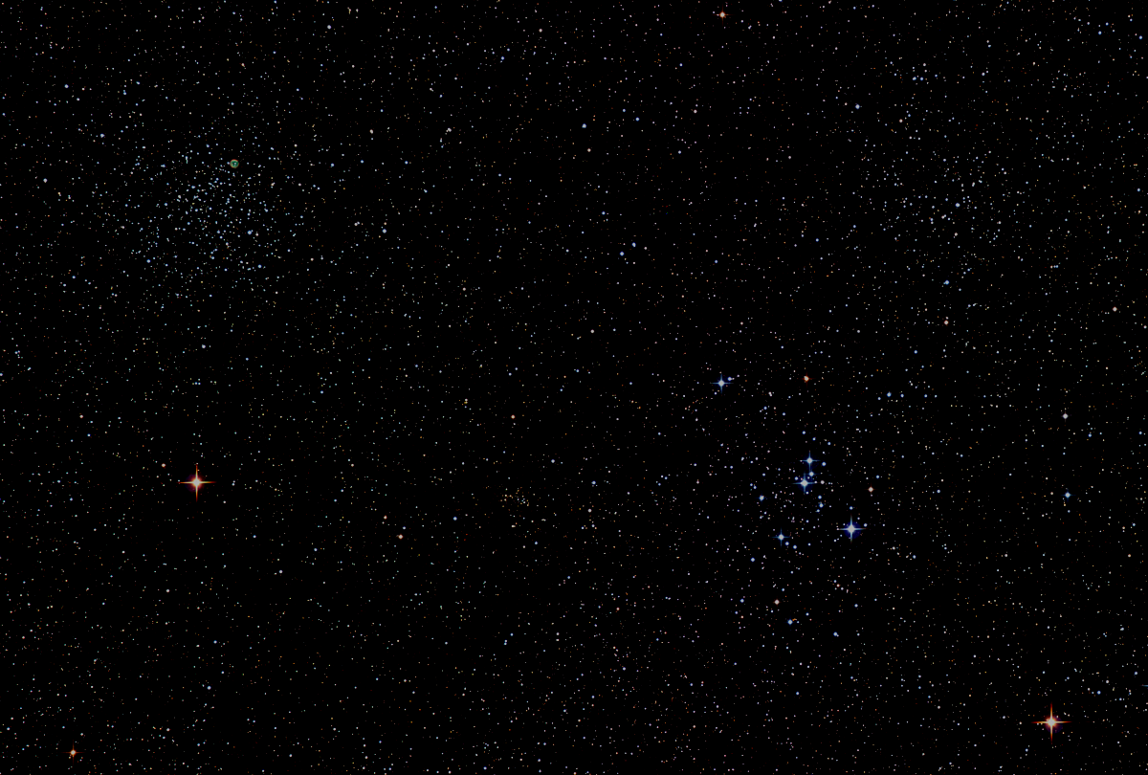

Howard
Astronomical
League
18
July 19th, 2018
Notes:
Howard Astronomical League, June 21, 2018

Slide 2
Introductions

Slide 3
Observatory Report Director: Joel Goodman
Plan:
Repair shutter
Integrate Robofocuser with scope and TheSkyX
Automate dome operation via TheSkyX
Continue training of existing CTOs
Begin training new CTOs
Make observatory available to members

Slide 4
SolarFest Report
Joel Goodman
Wayne Baggett
David Stein
Forest Arnold

Slide 5
Upcoming Events
HAL Events – Alpha Ridge Park
July 21st at 8:30 – Public Star Party
August 4th at 8:00 – Members Star Party
August 11th at 8:00 – Public Star Party
Other Events
August 9th to 12th – Stellafane, Springfield, VT
August 10th to 19th – Summer Star Party, Plainfield, MA

Slide 6
Three Oppositions in 79 Days!
Jupiter: May 8th
Saturn: June 27th
Mars: July 27th

Slide 7
Venus
15 Aug – Dichotomy (Half phase)
17 Aug – Greatest elongation east
25 Sep – Greatest brightness
26 Oct – Inferior solar conjunction

Slide 8
This Evening’s Speaker
Lou Mayo
NASA Sciences and Exploration Directorate
NASA Science Results from the
August 21st, 2017 Total Solar Eclipse
Notes:
It is my distinct pleasure to introduce Dr. Bindu Rani. She has been a Postdoctoral Fellow at NASA/Goddard Space Flight Center since July 2016, and will continue to hold that post until June 2019. She was also a Postdoctoral Fellow at the Max-Planck-Institut für Radioastronomie Bonn, Germany from February 2014 to June 2016. She has held visiting scientist and researcher positions at the Korean Very Long Baseline Interferometry Network of the Korea Astronomy and Space Science Institute, and The Gra-dig-nan Bordeaux Nuclear Research Center in France. Dr. Rani has experience in Gamma-ray, X-ray, optical, and radio astronomy. Her optical observational experience includes use of the 1.04 meter telescope at AIRES, Na-in-i-tal, India, and the 1.20 meter telescope at Mount Abu, India.
Among her many achievements, Dr. Rani was awarded the Otto Hahn Medal for outstanding scientific achievements by the Max Planck Society in 2015. She holds Bachelor and Master of Science degrees from University of Delhi and Da-yan-and University, respectively, in India. Last, and certainly not least, Dr. Rani completed her Ph.D at Max-Planck-Institut für Radioastronomie and University of Köln, both in Germany in 2013.

Slide 9
Member Astrophotos and Sketches

Slide 10
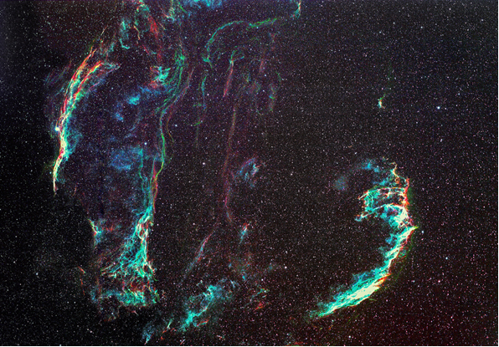
Veil Nebula Narrowband,
Reverse Hubble Palette
David Illig

Slide 11
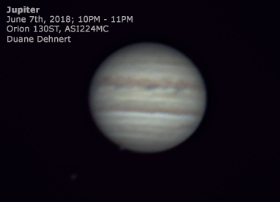

Slide 12
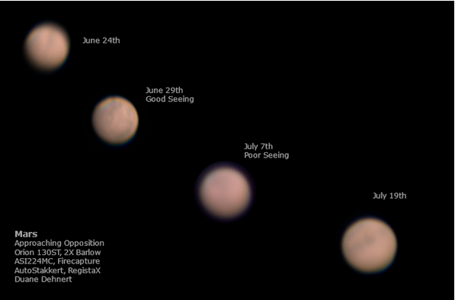

Slide 13
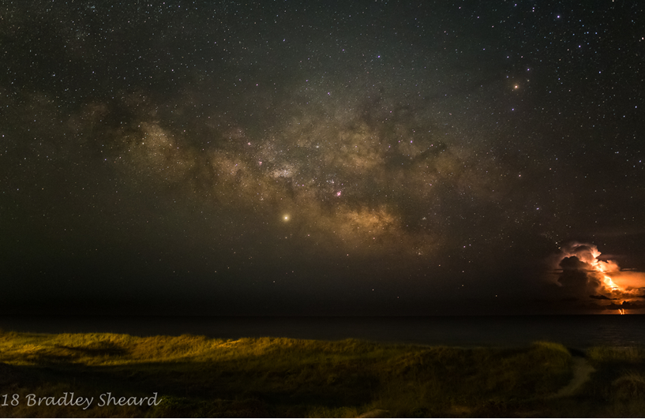
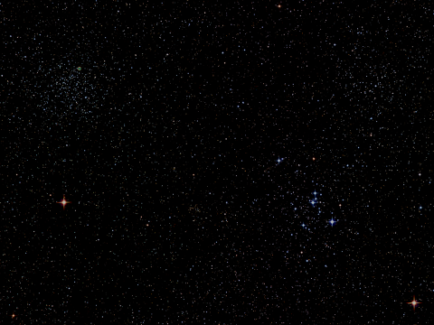

Slide 14
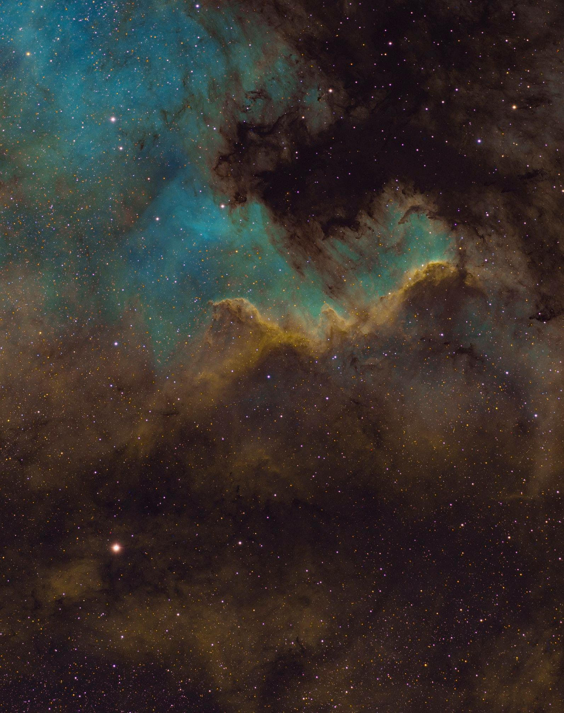
James Stack

Slide 15
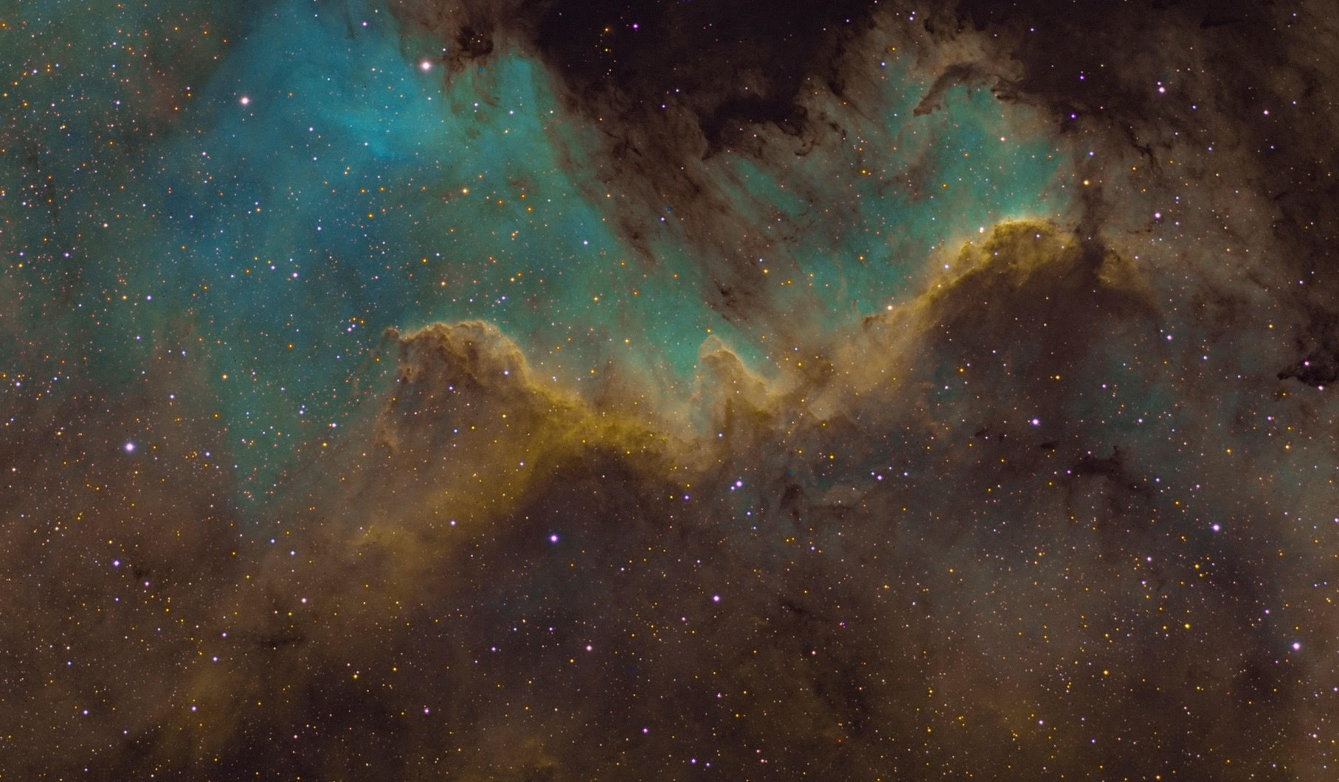
James Stack

Slide 16
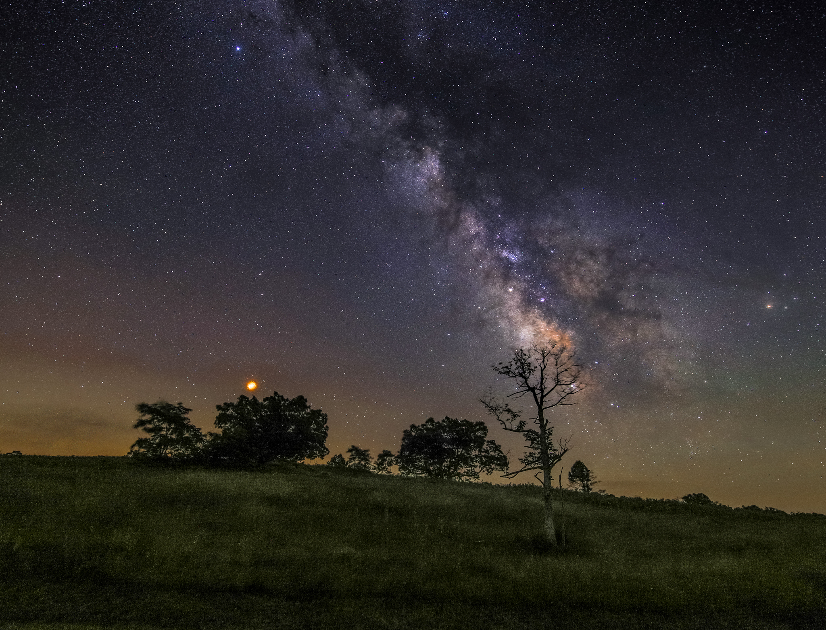
Big Meadows SNP
Cheryl Kerr, July 13, 2018

Slide 17

Salt Marsh Grasses in Sinepuxent Bay
Cheryl Kerr, June 16, 2018

Slide 18
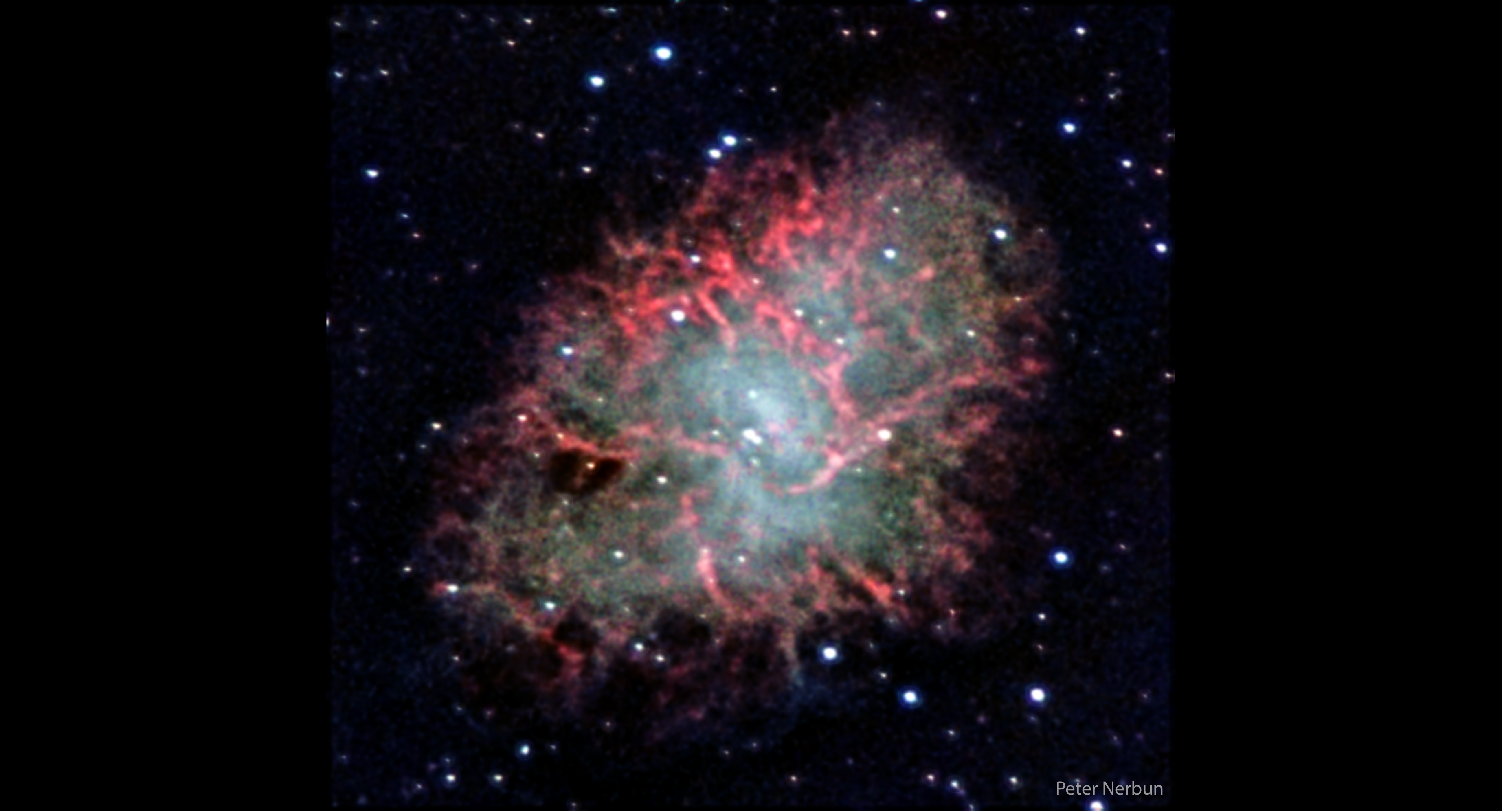

Slide 19
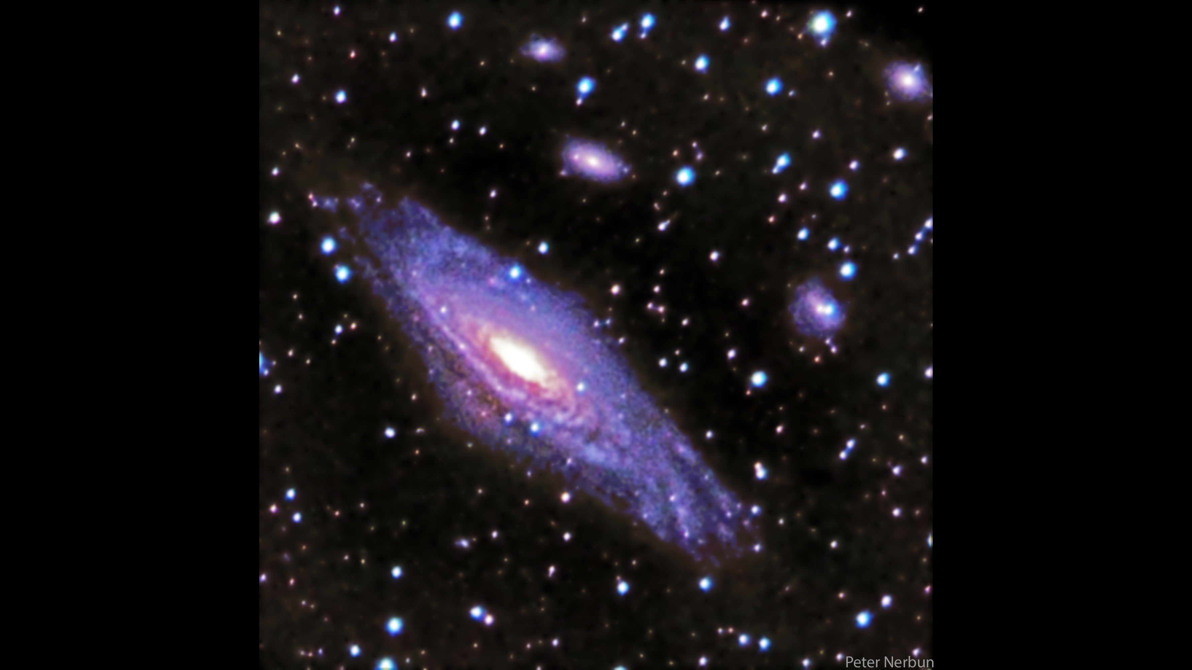

Slide 20
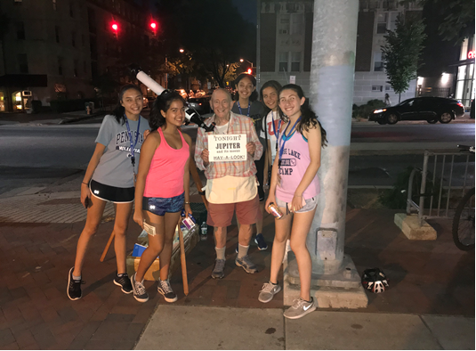

Slide 21
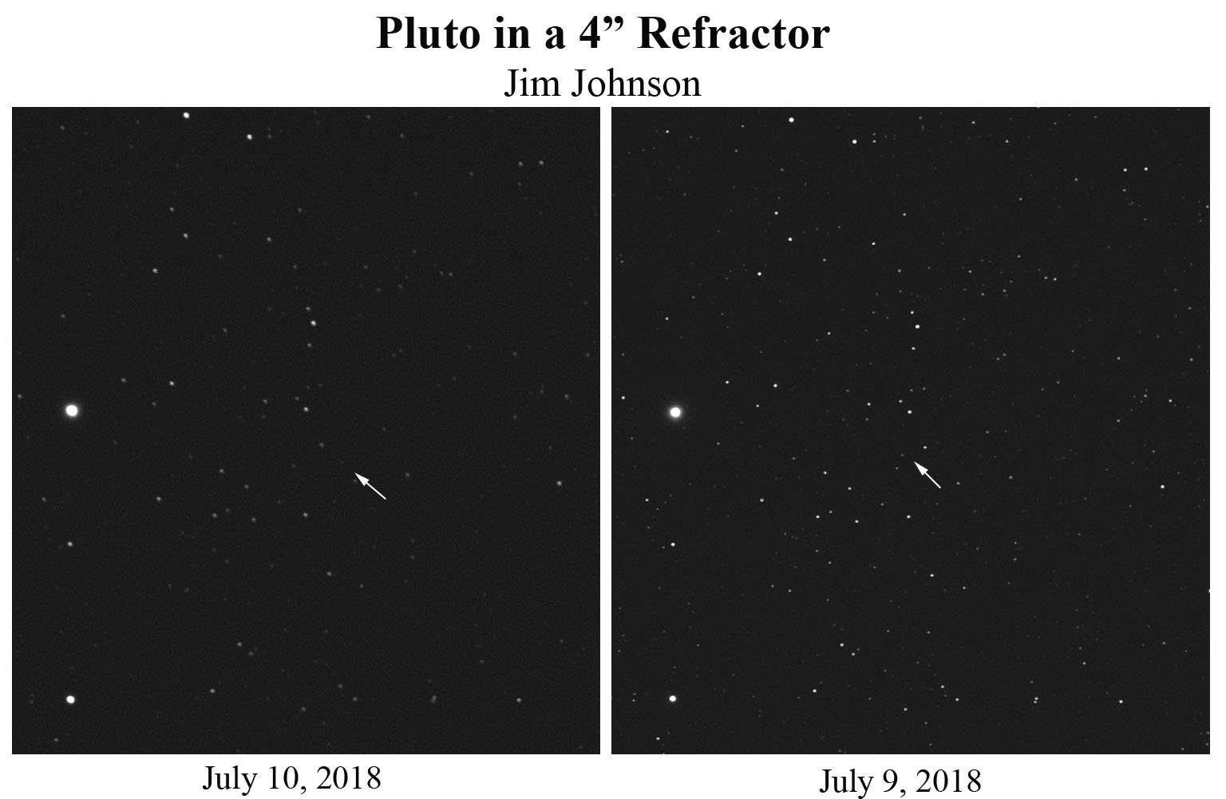

Slide 22
Thank You!
Next month’s meeting is on Thursday, August 16th 2018 at 7 PM
Dr. Tiara Diamond
NASA/Goddard Space Flight Center
Determining Initial Conditions for Type Ia Supernovae

